Slide 1
WEC 2021 Programming
Andrew Gillis, Jared Gillis, Spencer Comin, Nathan Darby

Slide 2
Overview
Presentation of our new and improved Chess.com

Slide 3
Notable Features
Authenticated logins from unique users
Ability to view all games that are ongoing for a given user and come back to unfinished games
Real time chess board view
Web application and Database mean that our application could be scaled up with no additional work.

Slide 4
Design methodology and schedule
Creation of class diagram and discussion or proposed basic solution (30 mins)
Define API for communication between the front and back end of the project (30 mins)
Split into two sub teams focused on backend and front end respectively, and begin developing ( 2 hours)
Status updates and any issues that were encountered up to that point (30 mins)
Continued development of front end and back end based off of API (2 hours)
Connection and debugging as connection issues were discovered (3 hours)

Slide 5
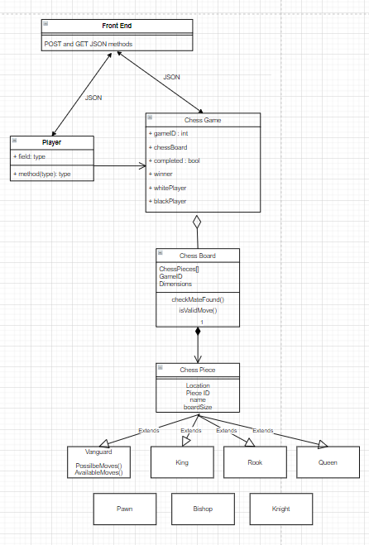
Detailed Design

Slide 6
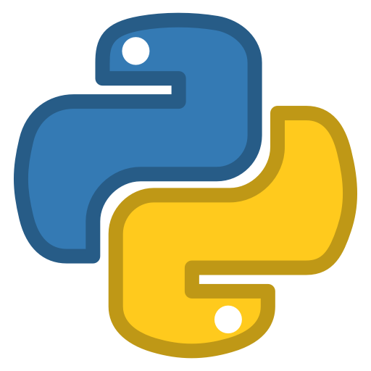
Design Choices: Python and PyCharm IDE
Lots of experience with Python on the team
Simple syntax allows for greater speed of development
The drawbacks don’t really affect a problem like this one
(Small data sizes, little requirement for maximum speed)

Slide 7



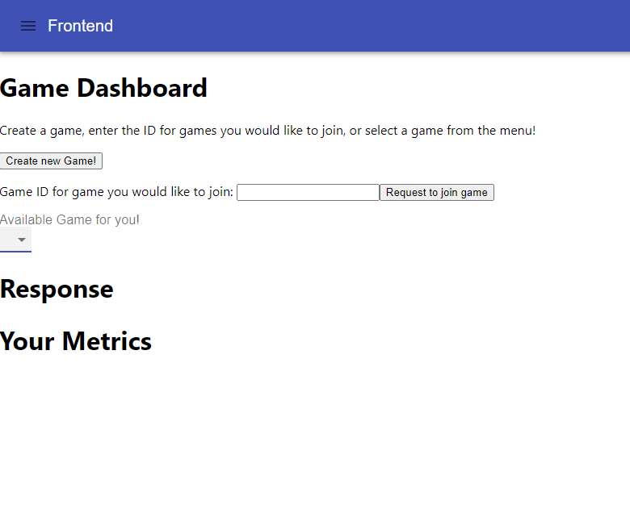
Front End Web app
React
A JS library useful for developing sleek and fast front end
Material UI
Library that is free to use within react with great documentation and components
Auth0
Online service with free tier that can be implemented with React for Authentication of users

Slide 8

Design Choices: Flask and Backend
Framework that we employed in the backend of our web application
In the backend we made use of micro services, a good design principle for modularity as it allows an application to be scaled up very easily

Slide 9

Design Choices: MongoDB
MongoDB is the most popular noSQL database, which allows for greater flexibility in development and allows for greater productivity as the application evolves
MongoDB has a free tier for their cloud based MongoDB Atlas service, this means MongoDB sets up the VM on an AWS server and takes care of all necessary “database back end” services such as load balancing, background update operations to ensure atomic operation (read/write to the database), and managing user connections giving us more time to work on other areas of the application
With this service we were able to test and debug our applications remotely from our own IDEs while ensuring we all had the exact same data to test our application
Scalability is also very easy with Atlas, as many tiers for different amounts of storage, connections, and retrieval speeds are available

Slide 10
Bugs and issues encountered
Communication from front to back end
This turned out to be the primary bug, and issue that we ended up encountering.

